Slide 1
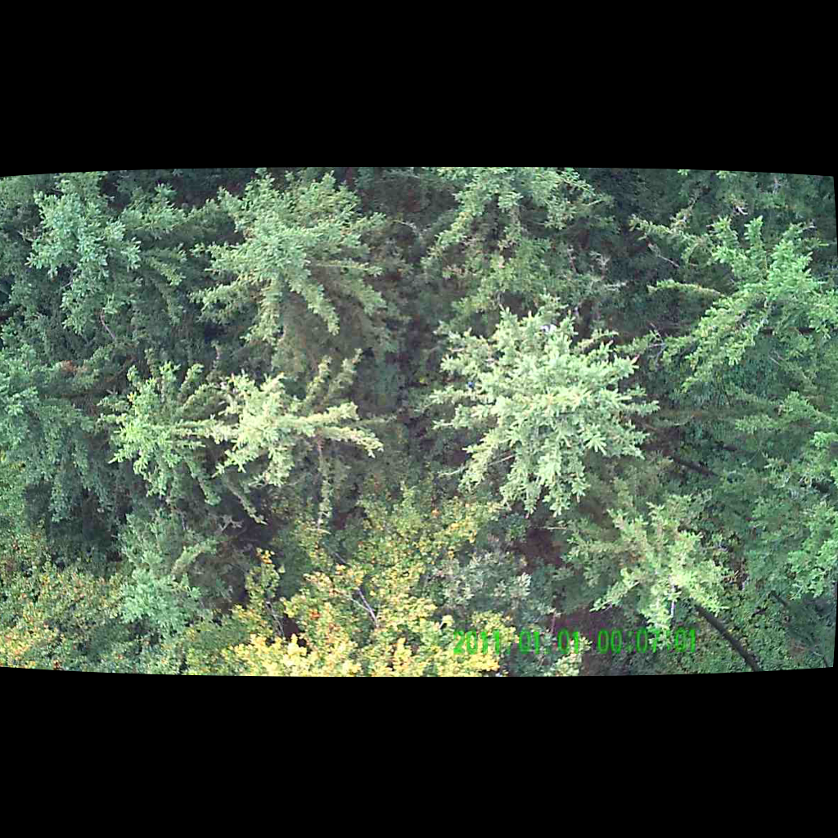
UNSUPERVISED PERSON LOCALIZATION IN WISAR Initial Ideas
Team C9
Nikolas Boldis Daniel Deutsch Lisa Schneckenreiter Uta Wagner
UE Computer Vision
9th December, 2021

Slide 2
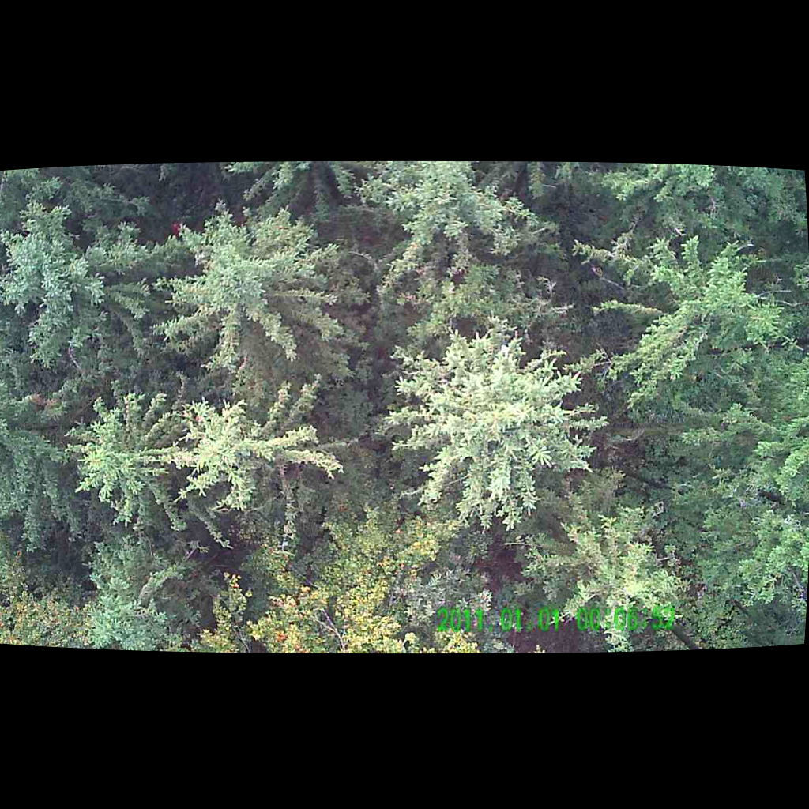
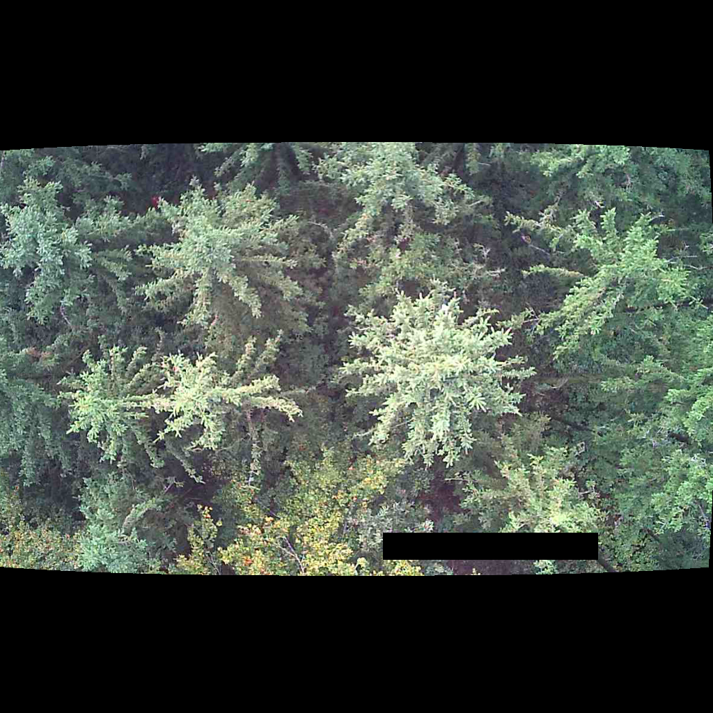

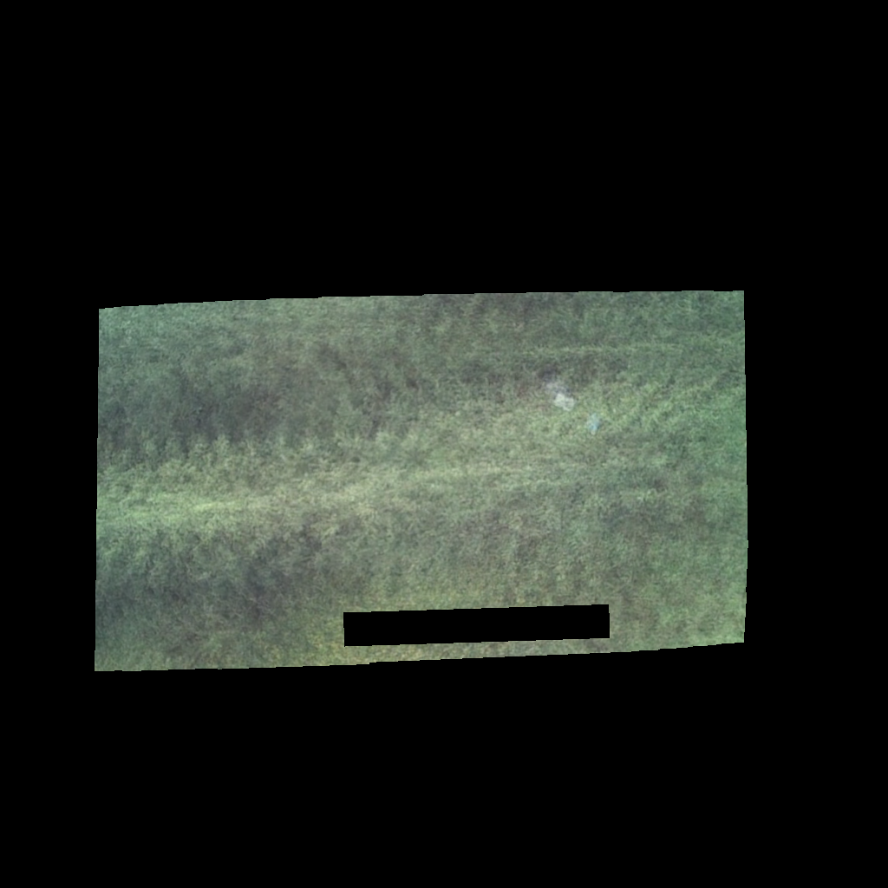
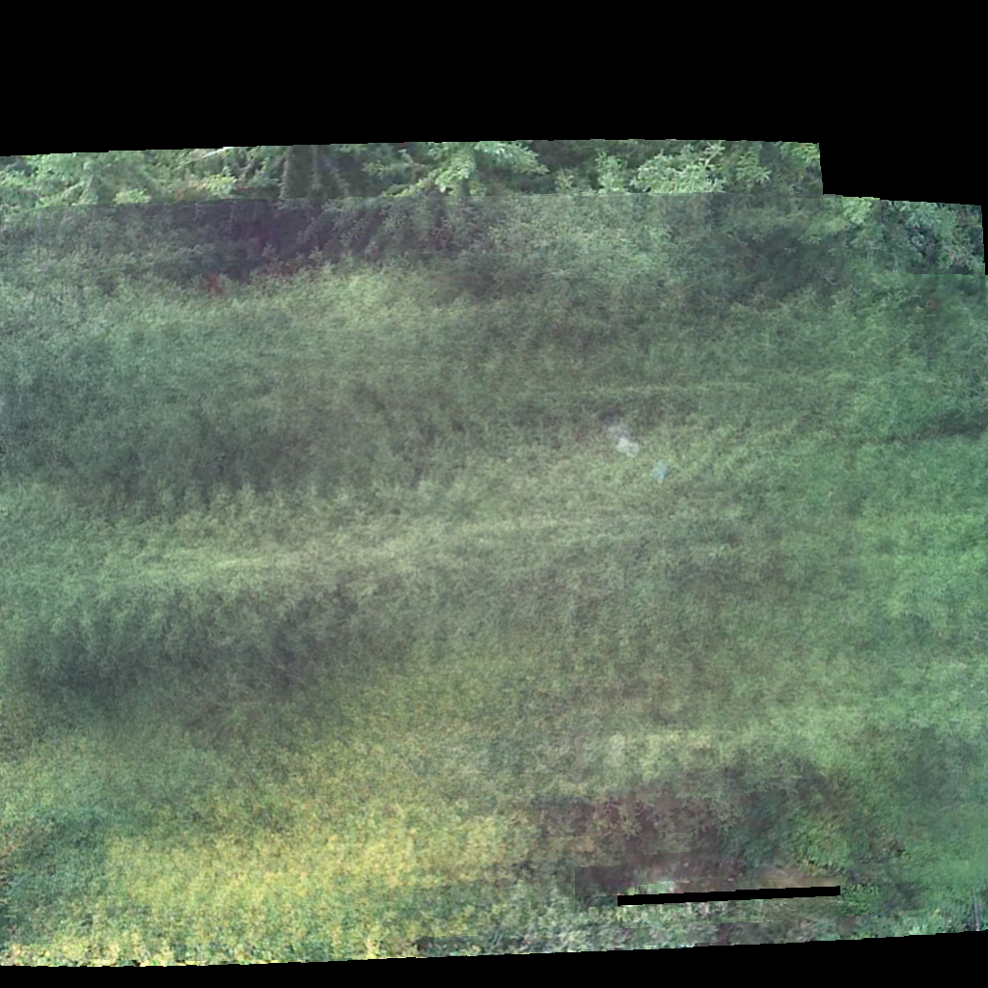
Image Pre-processing and Integration
1. apply mask for time stamp
2. warp to the same perspective
3. sum over parallel recorded images
4. remove areas not covered by all 10 images
UE Computer Vision, 9th December, 2021

Slide 3
UE Computer Vision, 9th December, 2021

Slide 4
UE Computer Vision, 9th December, 2021

Slide 5
THANK YOU FOR YOUR ATTENTION!

